Slide 1
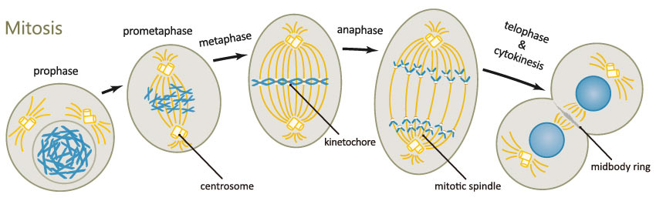
The Cell Cycle (and Mitosis)
Chapter 12

Slide 2
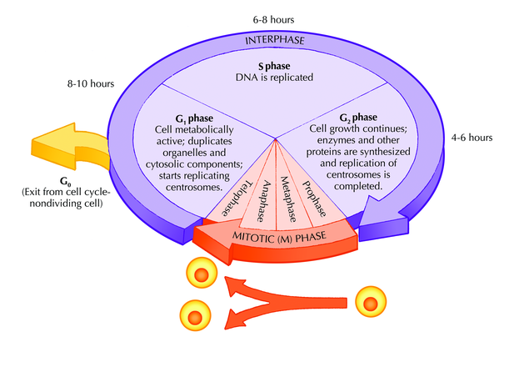
The Cell Cycle
Two phases:
  Interphase
    Longest phase of cell cycle
    When cell needs to divide, it begins getting ready in Interphase
      DNA is replicated during this phase
        Need 2x the DNA
      Additional cytoplasmic components synthesized during this phase
        Need additional organelles
      Cell grows
        Need extra plasma membrane
  Mitotic phase
    DNA and cytoplasm are divided during this phase
      Need to split DNA equally between the two new “daughter” cells
    Forms two genetically identical daughter cells

Slide 3
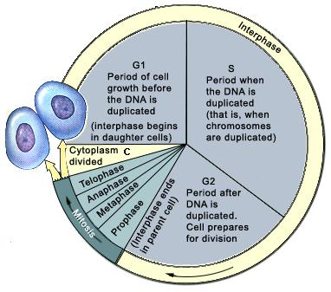
Interphase
Divided into three sub-phases:
G1: Gap₁ phase (“first gap”)
  Growth occurs when cell receives signal to divide
S phase (“synthesis”)
  DNA is replicated (synthesized)
  Centrosome is replicated
G2: Gap₂ phase (“second gap”)
  Growth continues
  Cell prepares to divide

Slide 4
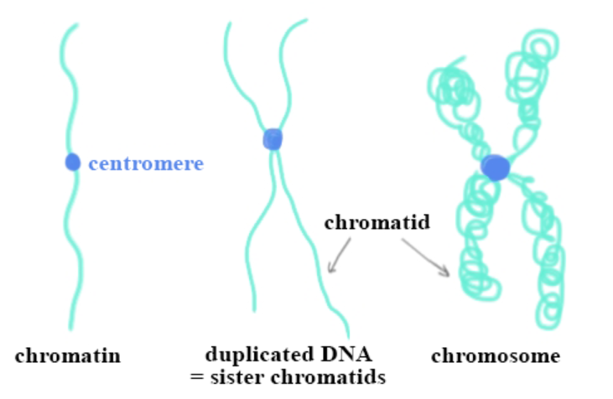
Vocab
Before duplication:
  chromosome (singular arm)
  chromosomes/homologs/homologous pair
Prepping for cell division
  Chromatin: uncondensed chromosome
Interphase/Duplication
  Sister chromatids: condensed and paired
Homologous chromosomes

Slide 5
Mitotic Spindle
Microtubules and associated proteins
Attach to chromosomes (sister chromatids) at the centromere, and move them during Mitosis
Centrosomes
  Hub of organization for microtubules
  Duplicated during Interphase to form two per cell
  These later migrate to the poles of the cell
Mitotic spindle fibers extend from centrosomes to attach to the chromosomes
  Attached to chromosomes at the kinetochore
    Specific location on centromere where proteins bind to facilitate attachment of mitotic spindle

Slide 6
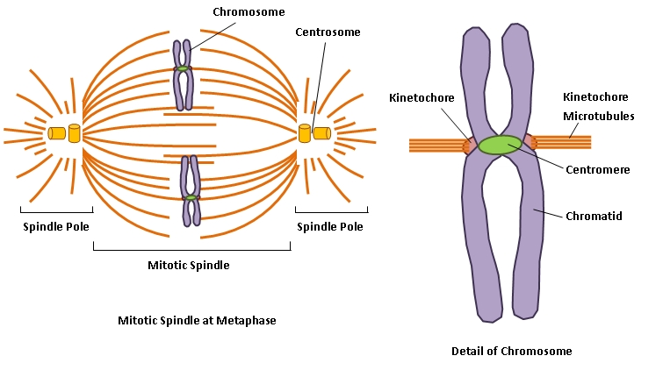
Mitotic Spindle
Sister chromatids

Slide 7
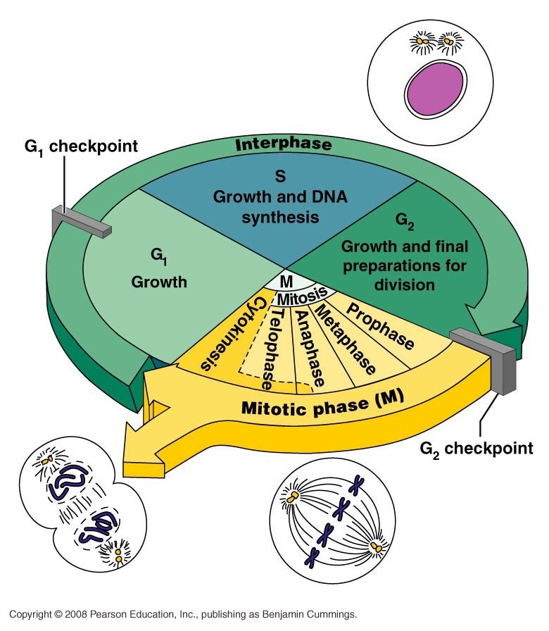
Mitotic Phase
Mitosis
  Replicated DNA is divided into two daughter nuclei
  5 phases
    Prophase
    Prometaphase
    Metaphase
    Anaphase
    Telophase/Cytokinesis

Slide 8
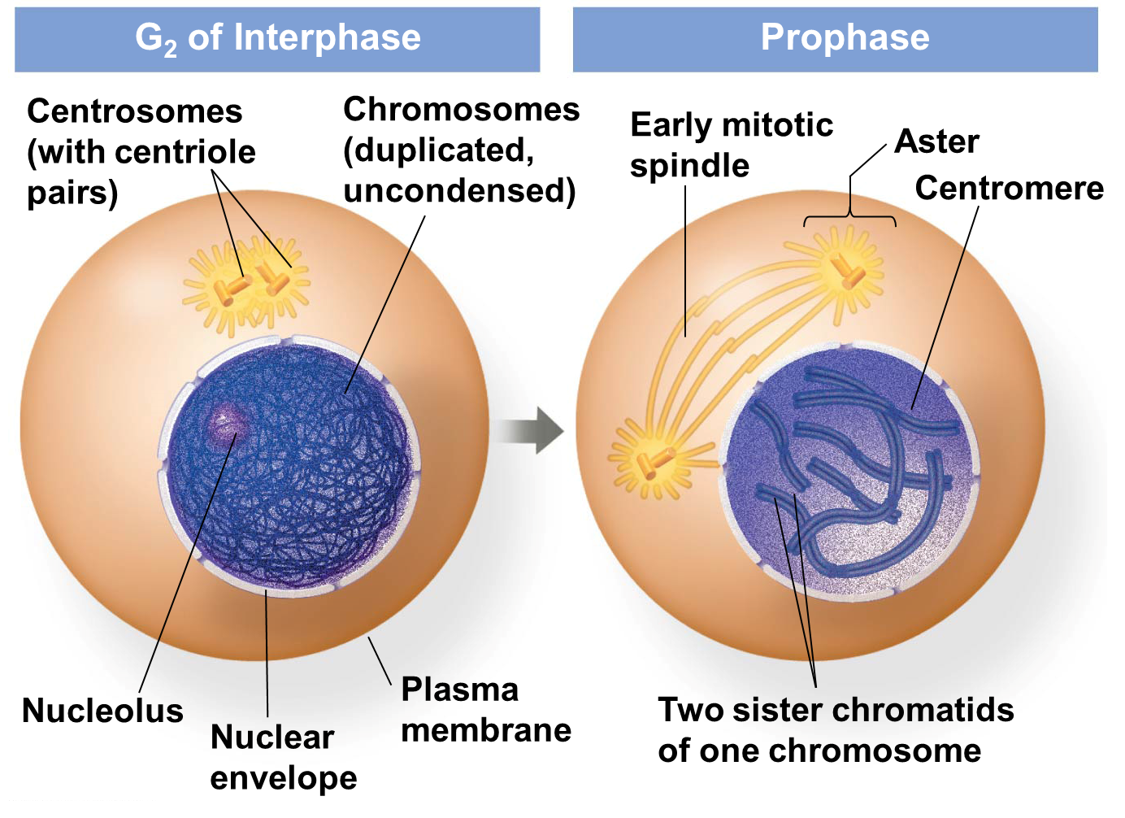
Prophase
Chromatin begins to condense into discrete chromatid
  Each replicated chromosome is comprised of
  two identical sister chromatids
Nucleolus disappears
Mitotic spindle begins to form from centrosomes
Centrosomes begin to move to opposite poles of the cell

Slide 9
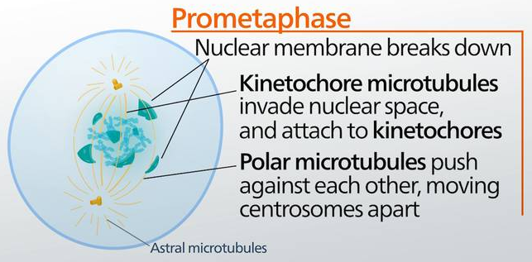
Prometaphase
Nuclear envelope begins to break down
  Microtubules can now enter nuclear region
Chromosomes condense further
Kinetochores form at the centrosome of each sister chromatid
Microtubules attach to chromosomes at kinetochore
  Called kinetochore microtubules
    Each sister chromatid has a microtubule attached, one from each pole
  Non-kinetochore microtubules extend the length of the cell, elongating it

Slide 10
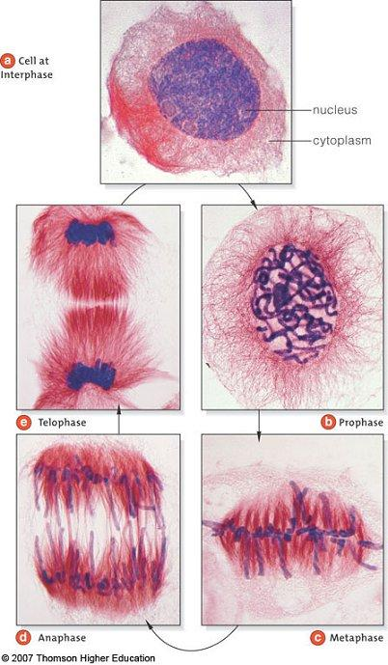
Chromosomes
DNA is not condensed during Interphase
  Cannot see individual chromosomes
DNA starts to condense during Prophase
  Can now see individual chromosomes

Slide 11
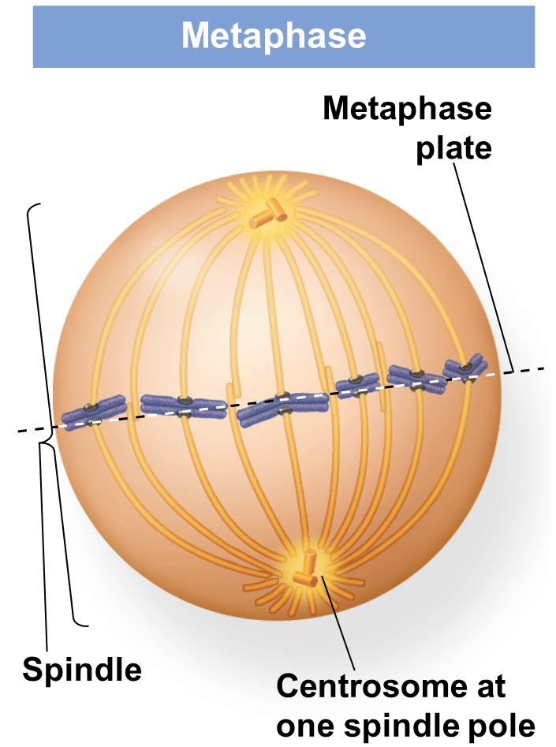
Metaphase
Centrosomes are now at opposite poles of the cell
Microtubules have attached to kinetochore of chromosomes
Chromosomes have been pulled to the equator of the cell
  Called Metaphase plate
  Sister chromatids line up at Metaphase plate

Slide 12
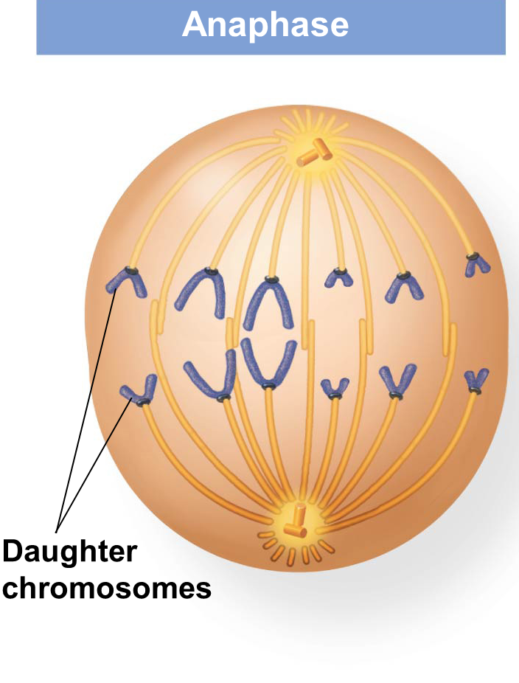
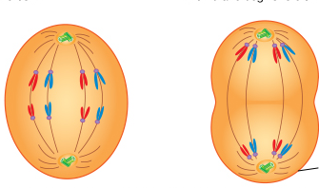
Anaphase
Cleavage of cohesion proteins holding sister chromatids together
Sister chromatids separate from each other
  Are now separate “daughter” chromosomes
Microtubules shorten
  Pull daughter chromosomes to opposite poles of the cell
Cell elongates
At end of Anaphase, each pole of cell contains
identical genetic material

Slide 13

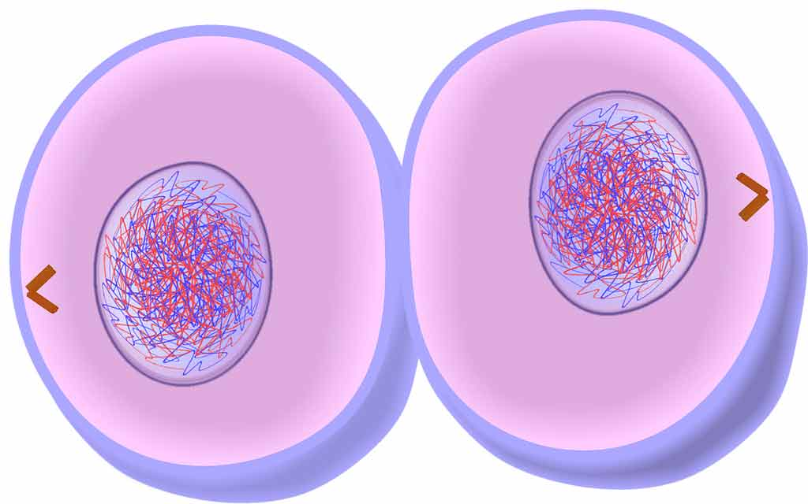
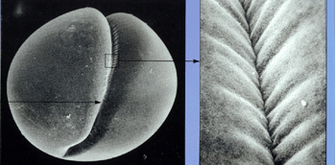
Telophase/Cytokinesis
Nuclear membrane forms around both sets of daughter chromosomes
Nucleolus reforms in each nucleus
Chromosomes are become less condensed
Microtubules are depolymerizing
Mitosis is complete once both nuclear membranes have reformed
Cytokinesis is division of cytoplasm into two separate cells
  Cleavage furrow forms
    Ring of microtubules which contract
    Pinch towards center of cytoplasm to form two daughter cells

Slide 14
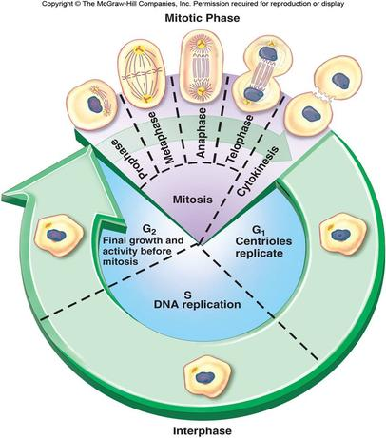
Putting it all together

Slide 15
Cell Cycle Control
Cell division/replication varies between different cell types
  Skin cells divide often
  Most somatic cells divide only when necessary
  Nerve cells never divide
Differences are due to molecular regulatory differences
  When should a cell go through mitosis?
  What happens if there is an error at some point along the way?
  How does a cell know when to stop dividing?

Slide 16
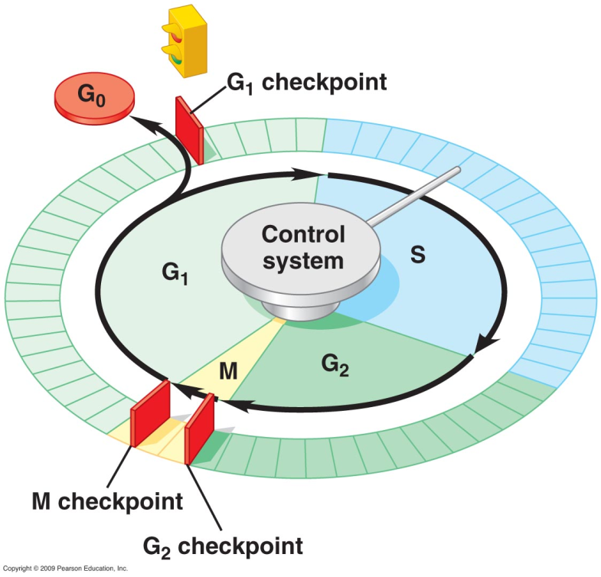
(Internal) Molecular Checkpoints
Cells have three main checkpoints within the cell cycle
  Gap₁
  Gap₂
  Mitosis
Each checkpoint has “stop” and “go-ahead” signals that regulate the cell cycle
  Do you check yourself before you leave your dorm/apartment/house?
    Have your keys? Yes? Go ahead No? Then stop
    Have your wallet? Yes? Go ahead No? Then stop
    Have your cell phone? Yes? Go ahead No? Then stop

Slide 17
Gap₁ Checkpoint
Called the “Restriction Point”
  Checks for:
    Growth factors
    DNA damage
    Cell size
    Nutrients
Crucial checkpoint for mammals
If “go ahead” signal is given at the G₁ checkpoint, cell continues through S phase and into Gap₂ phase
If “go ahead” signal is NOT given at the G₁ checkpoint, cell moves into a non-dividing state called G₀ phase
  After fully grown, most cells enter G₀ phase
  Most cells can be triggered back to a dividing state if necessary
    Injury

Slide 18
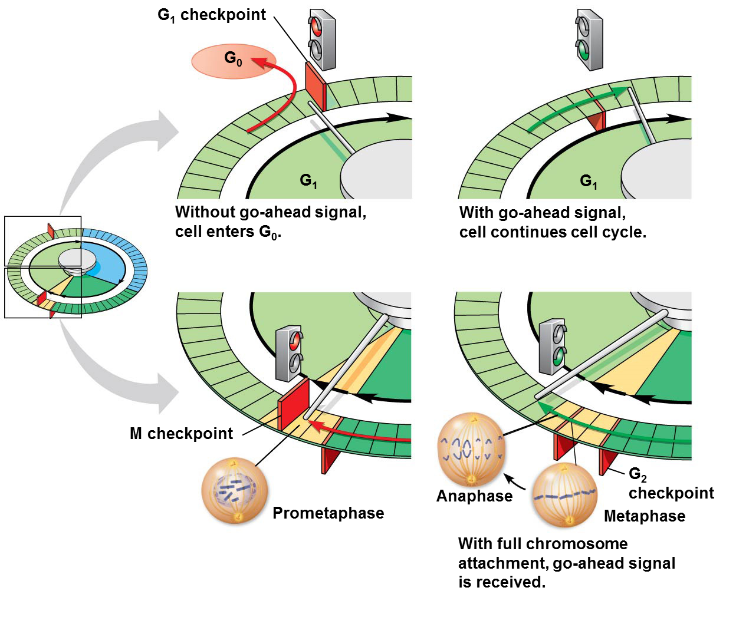
Gap₁ Checkpoint

Slide 19
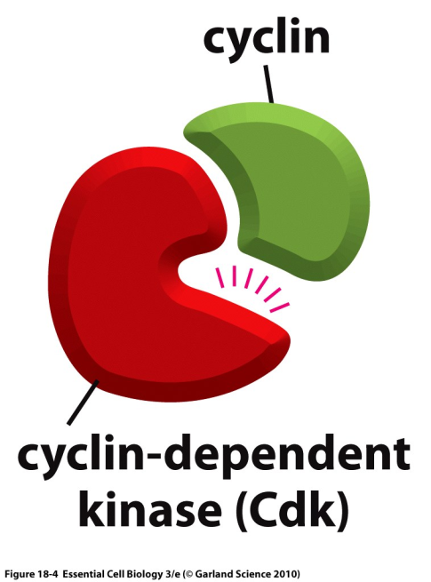
Cyclins and Cyclin-Dependent Kinases
Two types of regulatory molecules
  Cyclins
    Protein
    Concentration fluctuates throughout cell cycle
  Kinases
    enzymes
    They activate other proteins by phosphorylating them
    Concentration is consistent throughout cell cycle
      Mostly in inactive form
      To be activated they must be attached to a cyclin
        Cyclin-Dependent Kinase (Cdk)
    Activity of Cdks rises and falls along with cyclin concentration

Slide 20
GAP₂ Checkpoint:
Mitosis Promoting Factor
  Cyclin-Dependent Kinase (Cdk) + Cyclin = MPF
    When active, gives “go ahead” signal that triggers cell to proceed from Gap₂ to Mitosis
    Is active when cyclin levels are high
    Cyclin is produced late in S phase and in Gap₂
      Checks for DNA damage and proper DNA replication
    Is inactive when cyclin levels are low
  When MPF concentration is high, cell passes G₂ checkpoint and begins Mitosis
    MPF activity is highest during Metaphase
  During Anaphase, cyclin begins to degrade. Without cyclin there is no MPF.
    This triggers the cell to end Mitosis

Slide 21
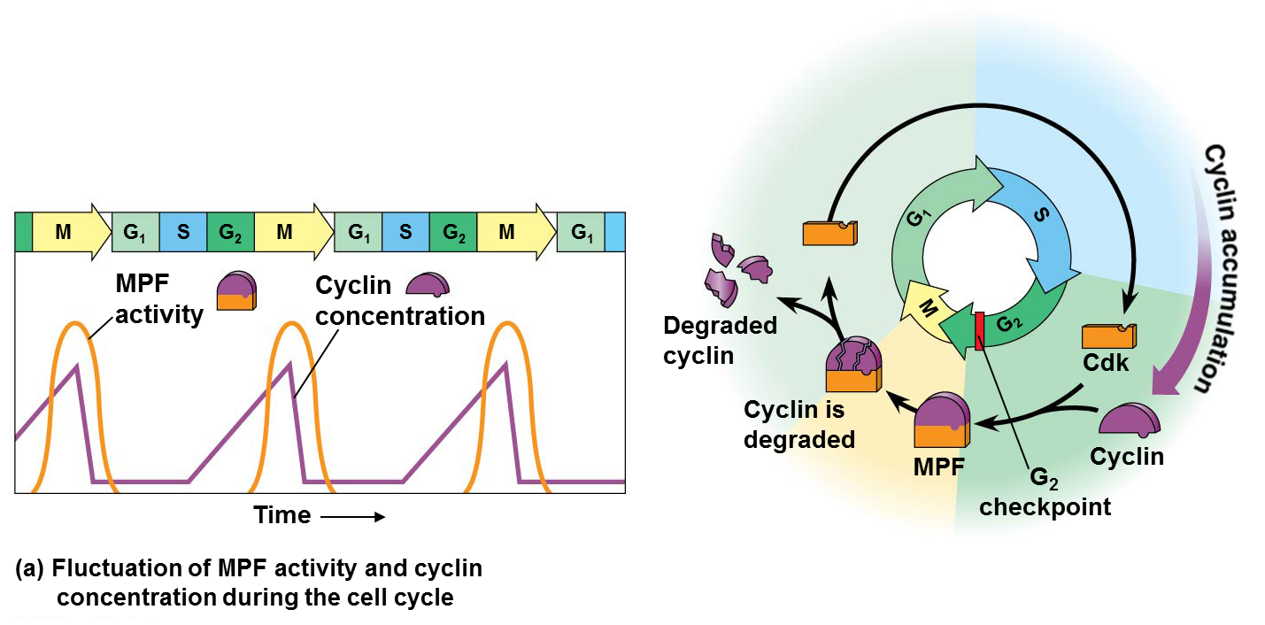

Slide 22
M phase Checkpoint
Checkpoint during Metaphase of Mitosis
  Checks that all chromosome kinetochores are attached to a microtubule spindle fiber
If “go ahead” signal is given, cell will proceed through Anaphase to Telophase
If “go ahead” signal is NOT given, cell remains “stuck” in Metaphase
  Cell can attempt to attach kinetochores correctly
  If it cannot, cell will eventually die

Slide 23
Cell Cycle Controls: External Factors
Density-dependent inhibition
  Cells stop growing when they get too crowded
    Example: wounds stop growing once they are healed
Anchorage-dependence
  To complete Mitosis, cells must be attached to a substrate such as another cell, or tissue matrix
    Example: Red Blood Cell Division mostly happens in the bone marrow, not free floating

Slide 24
Cell Cycle Controls and Cancer
Cancer cells do not follow normal cell cycle signals
  DNA damaged
    Genes damaged
Cancer cells grow and divide abnormally and uncontrollably
  Failure of at least one of the three internal checkpoints (G₁, G₂, M)
  Results in unregulated growth
Cancer cells can go through Mitosis without being attached to other cells, tissues
  Failure of anchorage-dependence
    Can continue to divide without proper attachment
  Results in cancer cells spreading to other tissues (metastasis)

Slide 25
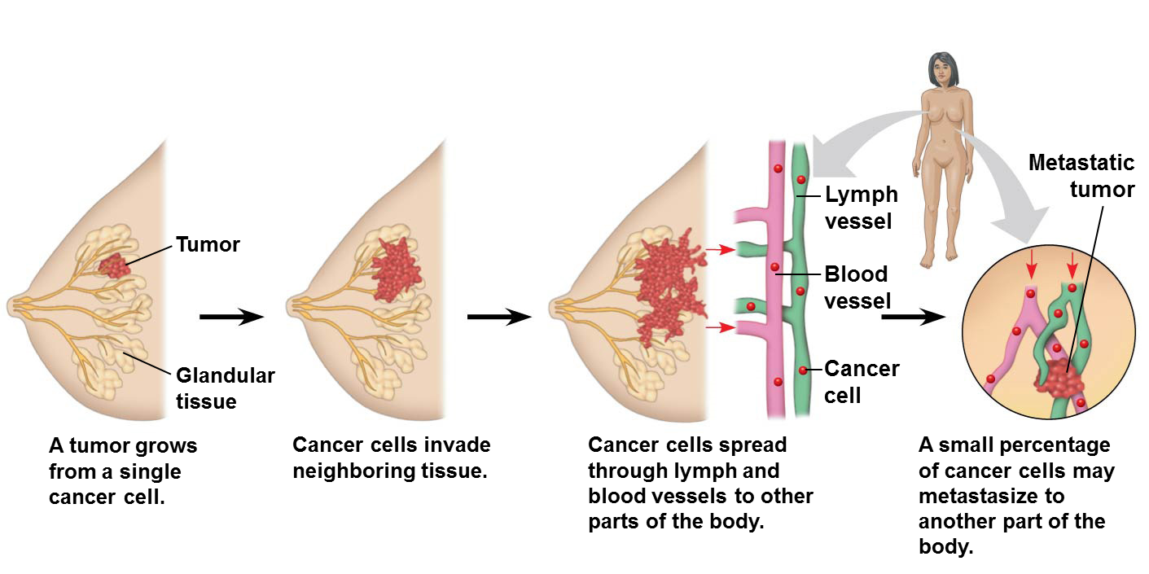

Slide 26
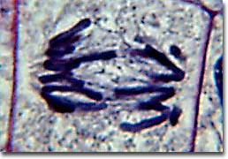
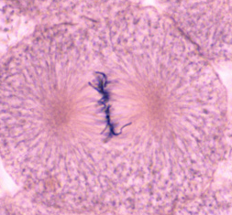
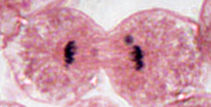
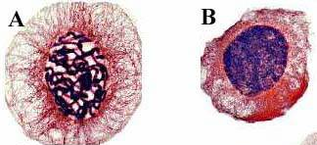
Mitosis practice
1. What phase of mitosis is this?
2. What phase of mitosis is this?
3. What phase of mitosis is this?
4. Which is Prophase?
5. Which is Interphase?

Slide 27
You should know….
List the four phases of Mitosis
What are the characteristics of Prophase?
What are the characteristics of Metaphase?
What are the characteristics of Anaphase?
What are the characteristics of Telophase/Cytokinesis?
What is the difference between diploid and haploid?
If an organism’s diploid number (2n) = 30:
  How many chromosomes does that organism have in its somatic cells?
  How many chromosomes in its gametes?

Slide 28
Mitosis practice
If 2n = 46
  How many chromosomes are there during Gap₁?
  How many sister chromatids are there after S phase?
  How many sister chromatids are there after Anaphase?
If 2n = 24
  How many chromosomes are there if the cell is in G₀?
  How many sister chromatids are there in Prophase?
  In what phase are sister chromatids separated?
  How many daughter cells are there after telophase/cytokinesis?
    How many chromosomes in each of those daughter cells?

